Slide 1

CAPSTONE PROJECT OF EDA ON TELECOM CHURN ANALYSIS
TEAM MEMBERS
PRATYUSH KUMAR RATH
BIKESH KUMAR MAHARANA
GAURAV SINGH

Slide 2
context
INTRODUCTION
BUSINESS PROBLEMS
DATA DICTIONARY
DATA INSIDES
DATA ANALYSIS
CONCLUSION
RECOMMANDATION

Slide 3
INTRODUCTION
Customer churn means shifting from one service provider to its competitor in the market.
Customer churn is a major problem and one of the most important concerns for large companies. Due to the direct effect on the revenues of the companies.
The average churn rate in telecom companies is 22% which is the most among other companies like IT(19%) and professional service(16%).
Losing customers is costly for any business. As per the authors of “Leading on the Edge of Chaos” [1], a 2% decrease in customer churn is equivalent to 10% reduction in costs.

Slide 4
BUSINESS PROBLEMS
Customer churn can down the company revenue with a major extent.
Consumers today go through a complex decision making process before subscribing to any one of the numerous telecom operator.
Moreover, as per the White House Office of Consumer Affairs [2], acquiring new customers is 6–7 times more expensive than retaining an old one.
Loyality of customers becomes an issue for the companies.
Identifying unhappy customers early, taking into consideration their values and the risk to churn, give you a chance to offer them incentives to stay.

Slide 5

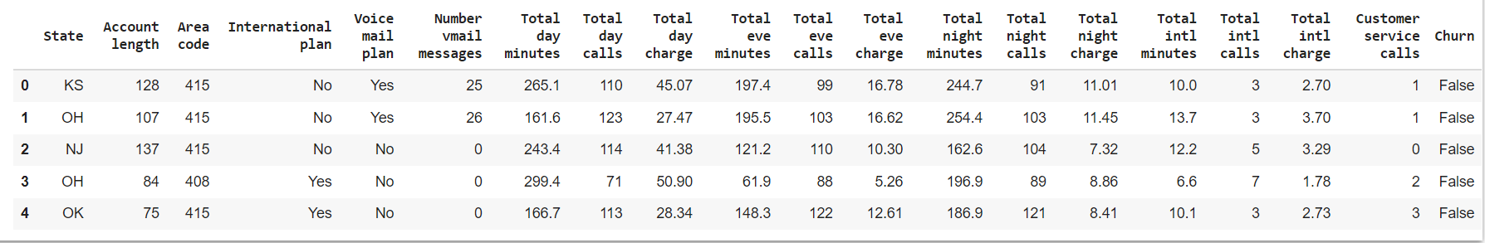
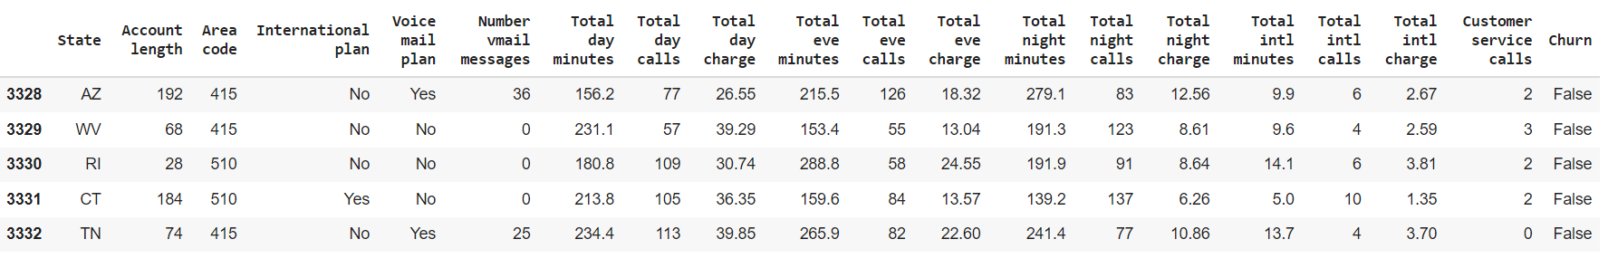
DATA SUMMARY
This is The Orange Telecom Churn Dataset.In the below table it’s show the top and bottom 5 rows respectively

Slide 6
DATA DICTIONARY
State : the state in which the customer resides, indicated by a two-letter abbreviation
Account Length : the number of days that this account has been active
Area Code : the three-digit area code of the corresponding customer
International Plan : whether the customer has an international calling plan: (yes/no)
Voice Mail Plan : whether the customer has a voice mail feature: (yes/no)
Number VMail Message : the average number of voice mail messages
Total Day Mins : the total number of calling minutes used during the day
Total Day Calls : the total number of calls placed during the day
Total Day Charge : the billed cost of daytime calls
Total Eve Mins : the total number of calling minutes used during the evening
Total Eve Calls : the total number of calls placed during the evening
Total Eve Charge : the billed cost of evening time calls
Total Night Mins : the total number of calling minutes used during the night
Total Night Calls : the total number of calls placed during the night
Total Night Charge : the billed cost of nighttime calls
Total Intl Mins : the total number of international minutes
Total Intl Calls : the total number of international calls
Total Intl Charge : the billed cost for international calls
Customer Service Calls : the number of calls placed to Customer Service
Churn : whether the customer left the service: true/false

Slide 7
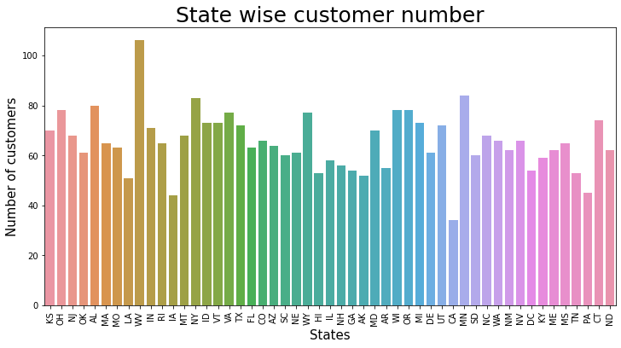
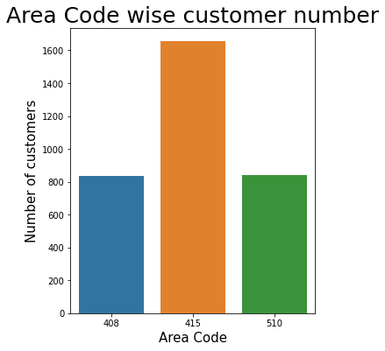
Data insides
There are 51 different states which is distributed among 3 area codes such as 408, 415, 510.
The state code 'WV' has the maximum number of customers while the state code 'CA' has the minimum customers.
For the area code 415 the number of customer are the maximum.

Slide 8
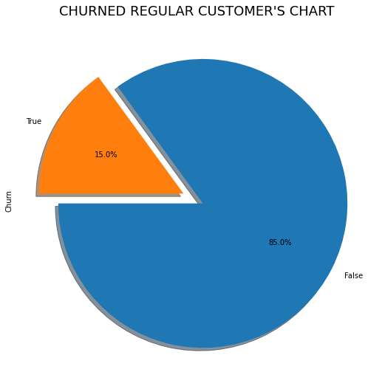
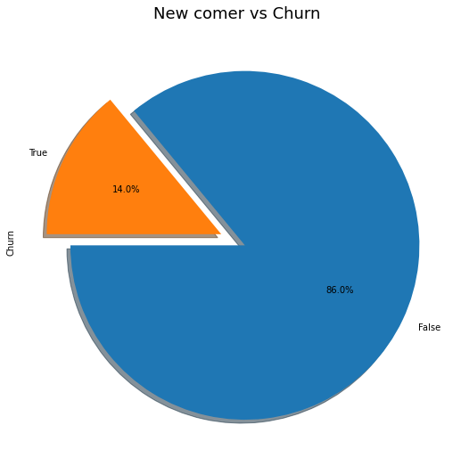
Data insides(cont.)
Here we may conclude that the percentage of churning is same for both regular and new comers.

Slide 9
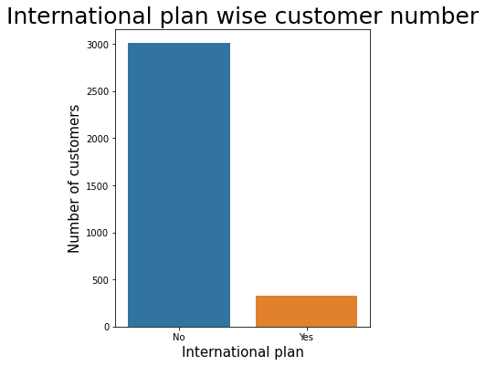
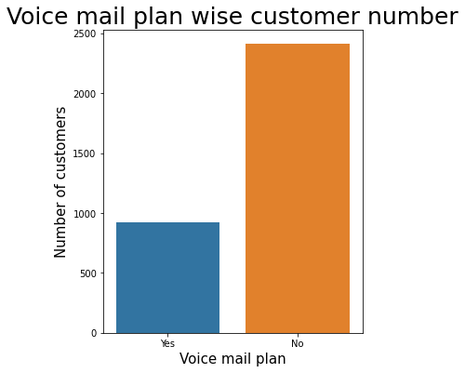
Data insides(cont.)
Number of international Plan
No 3010 = 90.309031%
Yes 323 = 9.690969%
Number of voice mail Plan
No 2411 = 72.337234%
Yes 922 = 27.662766
In both the cases the number of customers is very low.

Slide 10
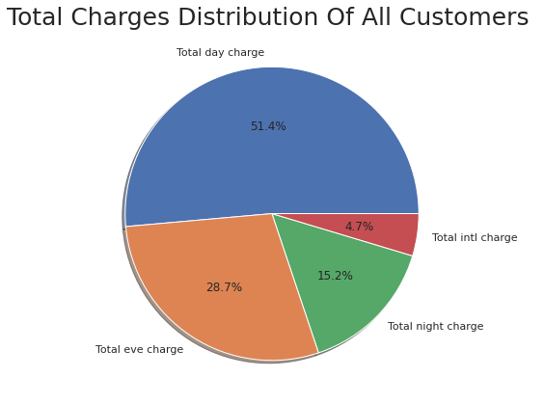
Data insides(cont.)
This plot shows the total revenue percentages of calls for the company.
From this chart we conclude that Total day charge is the highest and Total international charge is the lowest.

Slide 11
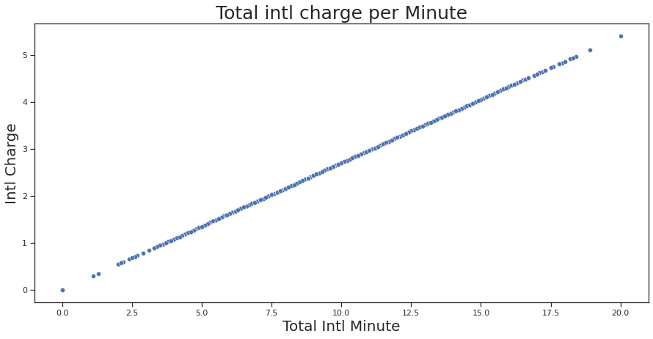
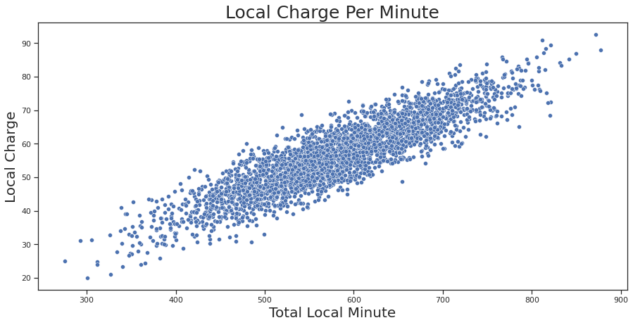
Data insides(cont.)
Intl charge per minute for each customer is constant.
But Day charge , eve charge and night charge per minute for different states are different.

Slide 12
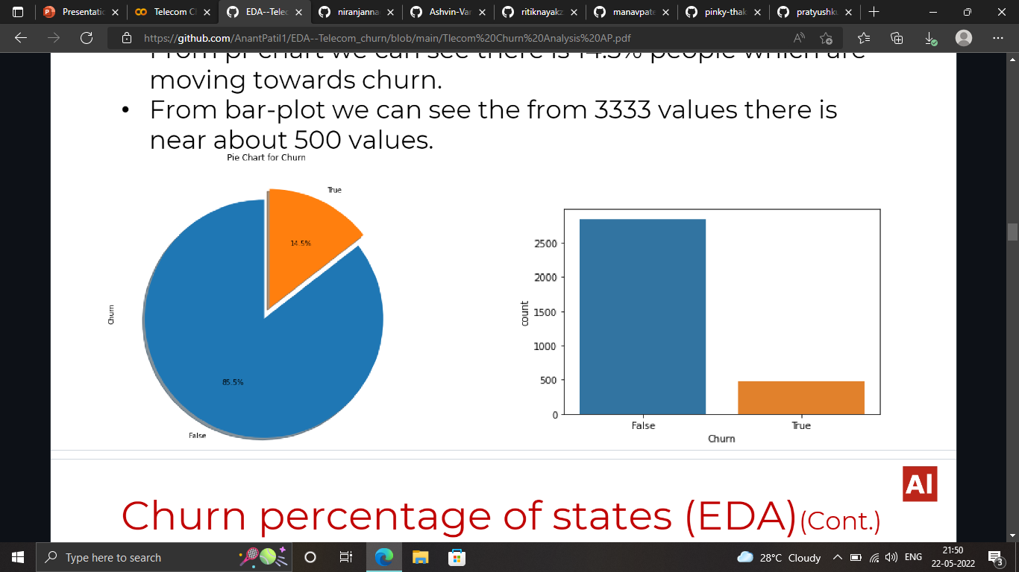
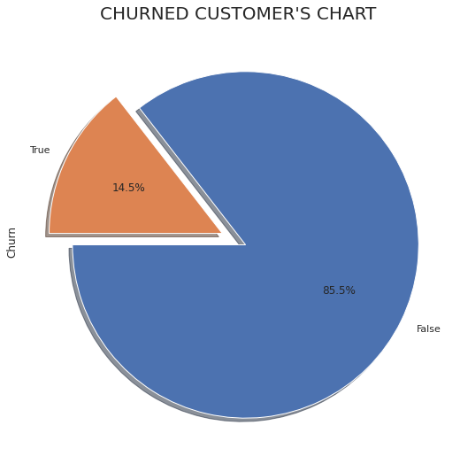
Churn count
Here we come to know that out of 3333 peoples 483 people have churned from the service whereas 2850 people still continuing.
We get to know that 14.5 percent of customers got churned and 85.5 percent of customers get remain with the company.

Slide 13
DATA
ANALYSIS

Slide 14
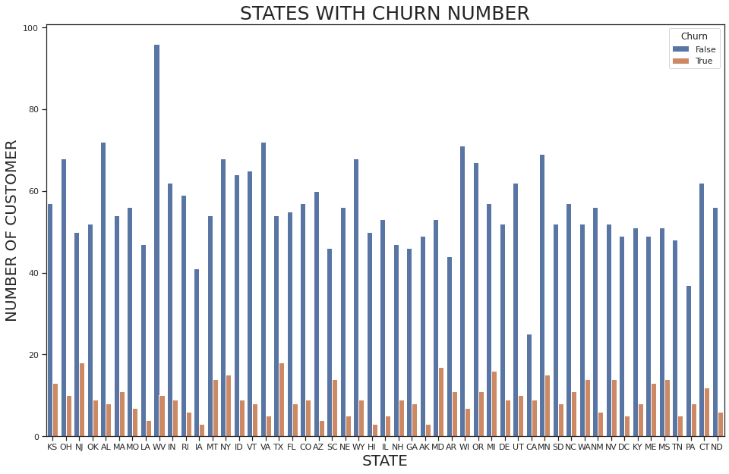
State wise churn count

Slide 15
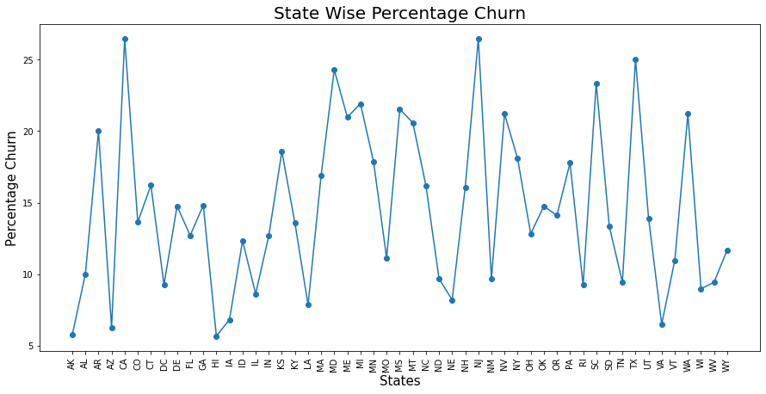
State wise churn count(cont.)
Churn Rate is maximum in states CA, NJ, TX and Churn Rate is minimum in states AK, AZ, HI.

Slide 16
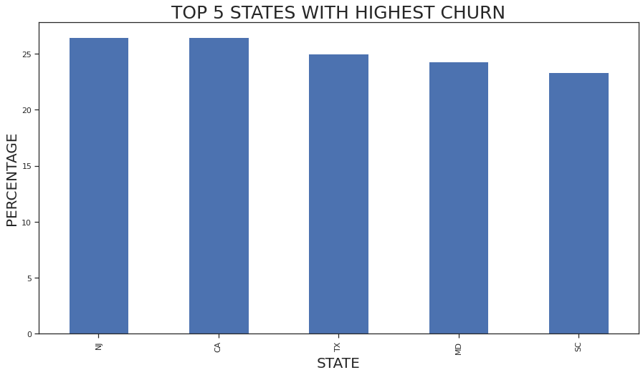
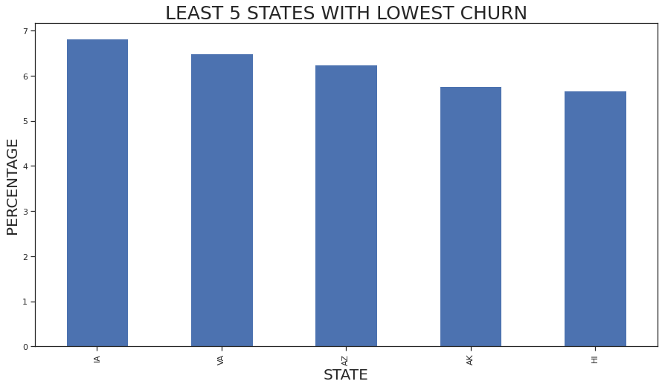
State wise churn count(cont.)
Here we can say that top 5 states which have highest number of churn percentage are (IN,CA,TX,MD,SC) .Theses states have to be careful towards customer because their loosing percentage is very high.
Here We Can Say That Top 5 States Which Have Lowest Number Of Churn Percentage Are (IA,VA,AZ,AK,HI) So By Analysis We Get To Know That They Provided Good Services Compare With Other States.

Slide 17
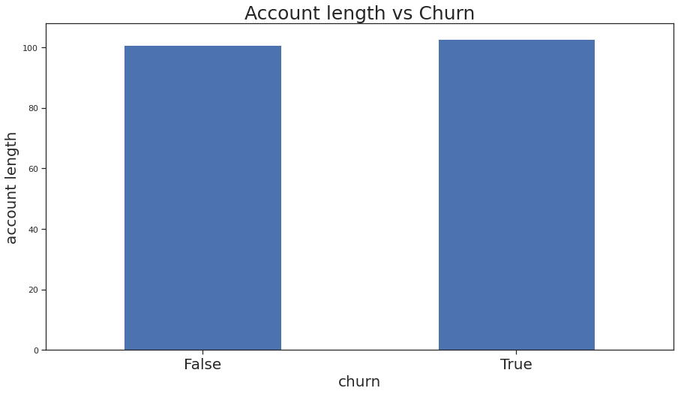
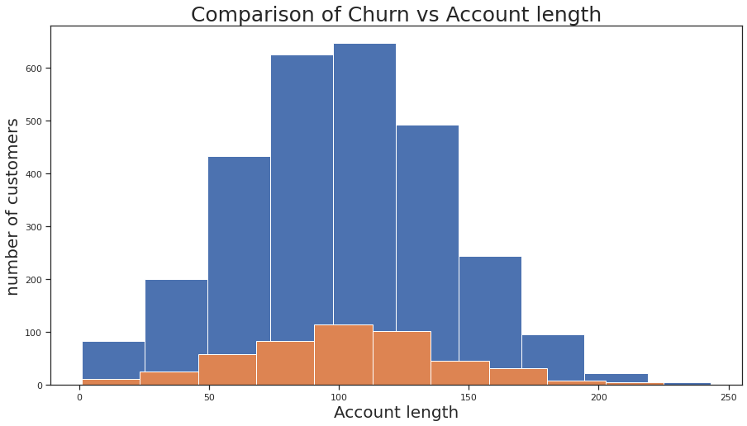
Account length vs churn count
The churn rate is proportional according to the account length.
The churned people and non-churned people have almost same average of account length

Slide 18
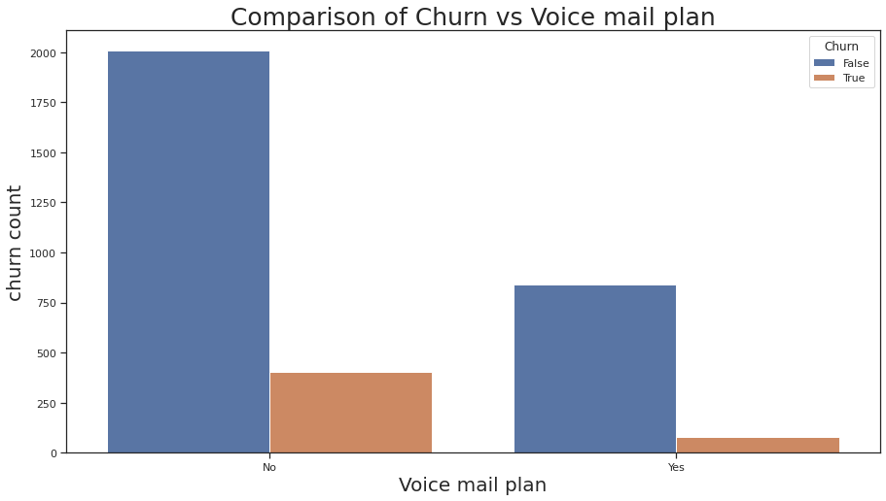
Voice mail vs churn count

Slide 19
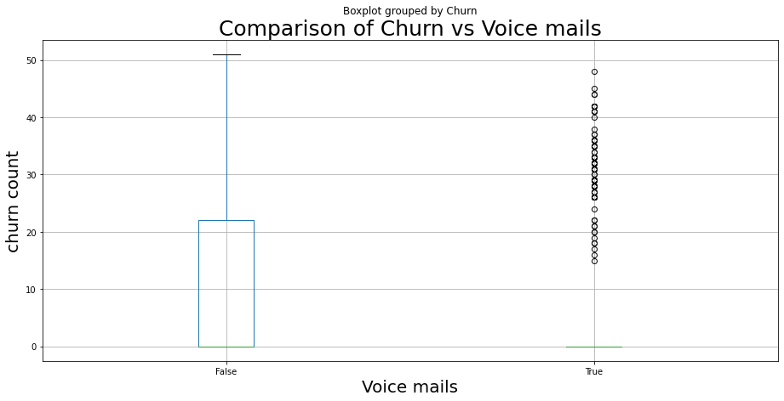
Voice mail vs churn count(cont.)
Here we can say that if the number of voice message is more than 20 Then there shows a churning.

Slide 20
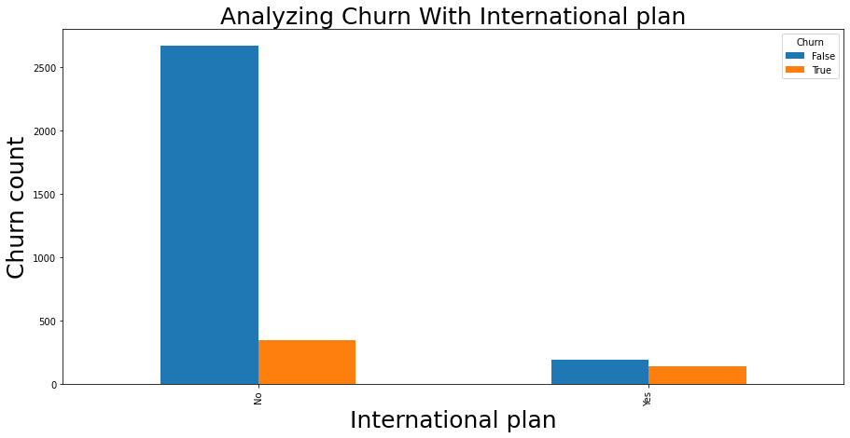
International plan vs churn
Now the major cause shows that, the number of active international plans make a good cause for the people for churning.

Slide 21
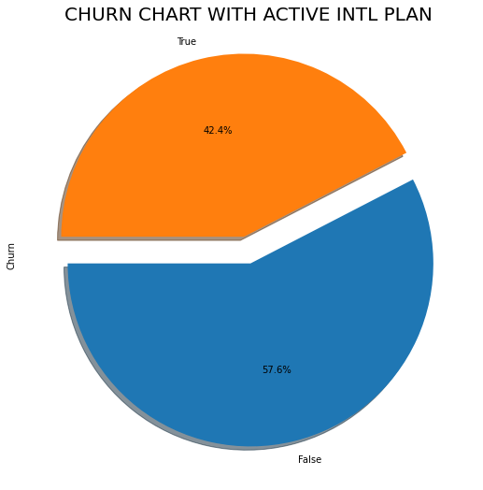
International plan vs churn (cont.)
Now it is clear that almost half of the people having intl. plan are getting churned.
There may be issue with their Charges or may be with Their network.

Slide 22
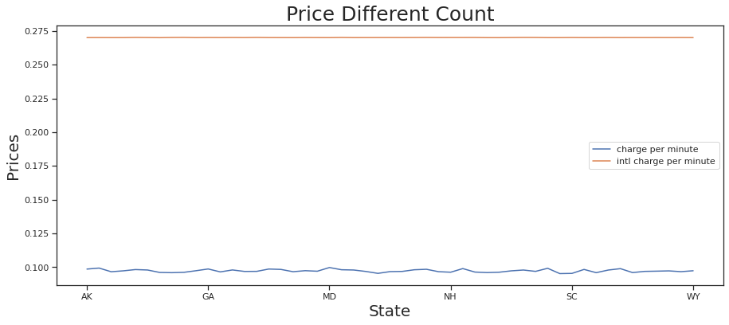
Price difference analysis
By this graph we can see that there is huge difference between the local charges to the intl. charges. Which refers that the high pricing of intl. charge may cause churning.
Average Charge per minute for each customer is 0.09728939604058527 units.
Intl charge per minute for each customer is 0.27005654558216496 units.

Slide 23
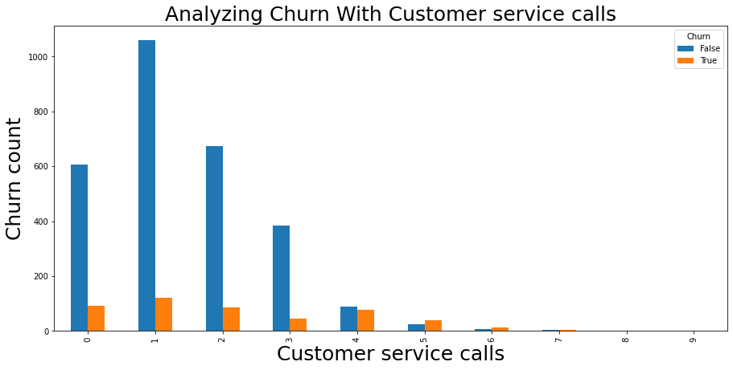
Customer service call analysis
Here we can see, when the service calls are 0, 1, 2, 3 there is no such issues.
But when the customer service call is 4 or more than 4, we can see some actions of churning. Which indicates that customers with more service calls is going to churn very easily.

Slide 24
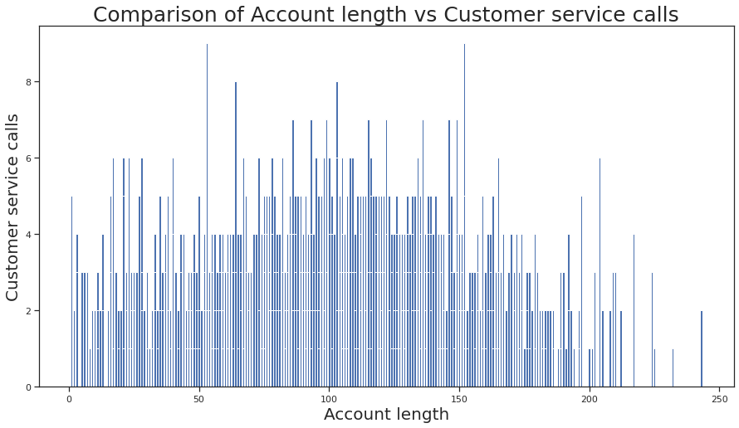
Customer service call vs account length
We can see a increase in customer service call around 50 to 150 account length.

Slide 25
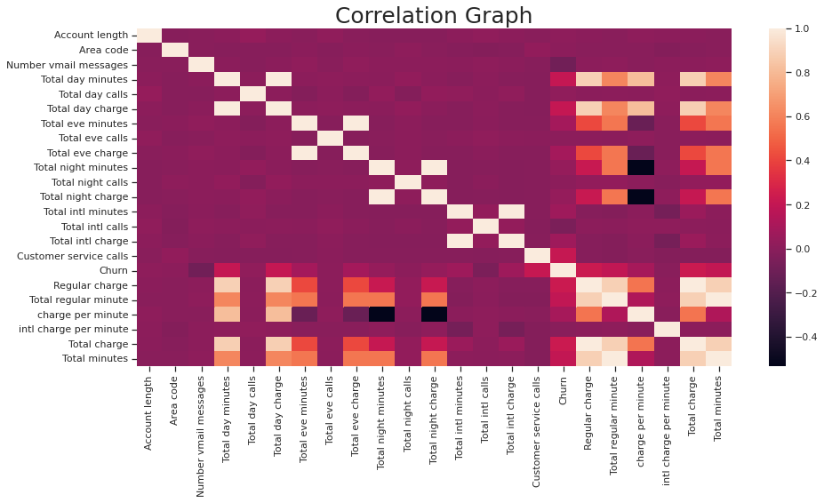
Correlation matrix
In the correlation graph we can see that churn is related to charges, minutes and customer service call in some extent.
So now let's analyze this relations and find the cause.

Slide 26
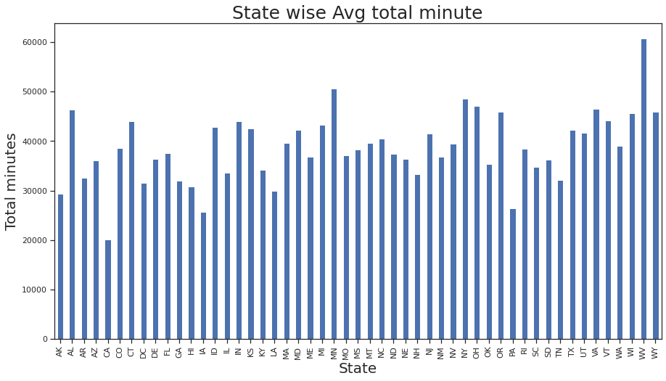
State wise total calling minute
Here also the state which has highest minutes of call is 'WV' and the least in 'CA'.

Slide 27
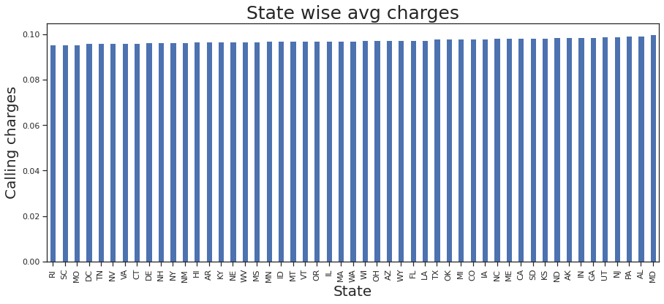
State wise calling rate
Here we can see that the call charge rate is higher in state code 'MD' and lowest in 'RI'.
We can see that 'CA' which has lowest customer has a higher charge rate.

Slide 28
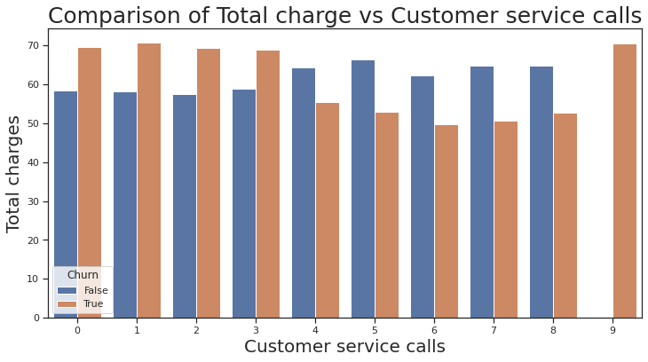
TOTAL CHARGE VS CUSTOMER SERVICE CALL
Here we have seen that, the 1st 3 lines shows the pricing of charges leads to customer service calls which may results in churning.
But we can't the same for rest lines.
But when there is 9customer service calls there are all in churned.

Slide 29
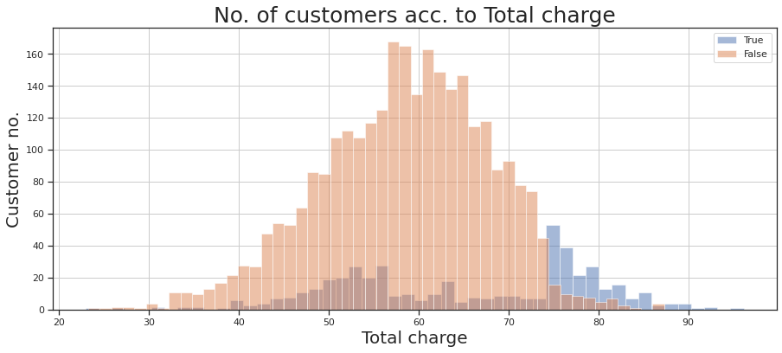
CHURN VS TOTAL CHARGE
When the price rate go beyond 74 units, the rate of churn is increased dominantly.

Slide 30
CONCLUSION
From the 'CHURNED CUSTOMER'S CHART' we found that the churn rate is 14.5%.The average Churn rate for Telecom company should be 20-25%.So here Churn rate is good.
The graph 'State Wise Percentage Churn' and 'State wise avg charges' indicate that although state 'CA' has maximum churn rate, lowest customer but avg local charges are relatively more as compared to other states.
By referring to 'Price Different Count' chart we conclude that international charge per minute is very much higher than the local charge per minute.
Chart 'No. of customers acc. to Total charges' clearly shows churn rate is maximum when total charges exceeds more than '74'.
From "Analyzing churn with customer service calls" it is pretty much clear that The churn rate is more when customer service calls exceed '4'.It also shows that churned customer much more than the existing customer.
From "Voice Mail Analysis" it is found that when the number of voice mail increase 20, there is churning. This may be due to Quality of Voice Mail.
From the scatter plot 'Local Charge Per Minute' , We Conclude Day charges, eve charges, night charges are not same.
By comparing 'Churn vs Intl plan' it is concluded that 50% of the people get churned those take the international plan. It may be due to higher charges or may be due to network issue.

Slide 31
RECOMMANDATION
Local charges are not same for day, evening and night so to reduce churn rate the company should make Local charge uniform.
We observe that more churn is due to expensive intl. charge per minute so it should reduce its intl. charge to reduce churn rate.
In some particular states churn rate is much higher than that of others may be due to network issue. So It should focus on these states to reduce churn rate.
It should improve its customer service and take frequently feedback from the customer regarding their issue and try to solve it as soon as possible

Slide 32
THANK
YOU

